Slide 2
Embedded academy Pre-course

Slide 3
Content
Introduction
Hello world
h-files and c-files
Bit operations
Boolean expressions
Unions
Strings
Types and type conversion
Macros
Pointers

Slide 4

Who am I?
33 years old
Studied engineering physics at Chalmers
Started at Box of Energy, startup in Gothenburg
Previously four years at Aros electronics
Working at Knowit since May 2022 with engcon

Slide 5
Hello world

Slide 6
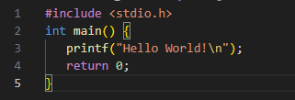
Hello world
Includes standard IO library.
Contains main function, which is the starting point
printf is implemented in stdio.h and will handle the printing of the message
returns something to the caller

Slide 7
h-files and c-files

Slide 8
h-files
h-files and c-files
Header files
Contains declaration of public functions, types and similar
Could include other header files, needed by the user
Should never declare variables (even though possible)
Be conservative with what’s declared in the header file
Remember include guard

Slide 9

c-files
h-files and c-files
Source files
Implements functions
Includes h-files as needed
Including files could be done either by “” or by <>

Slide 10
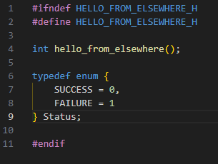
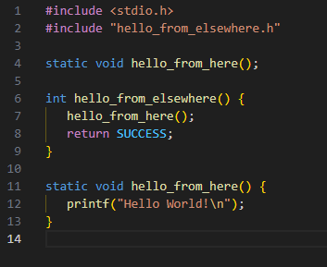
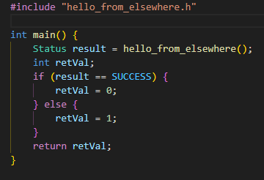
Example
h-files and c-files
hello_from_elsewhere.h
Source files
Implements functions
Includes h-files as needed
hello_from_elsewhere.c
hello.c

Slide 11
Types and type conversion

Slide 12
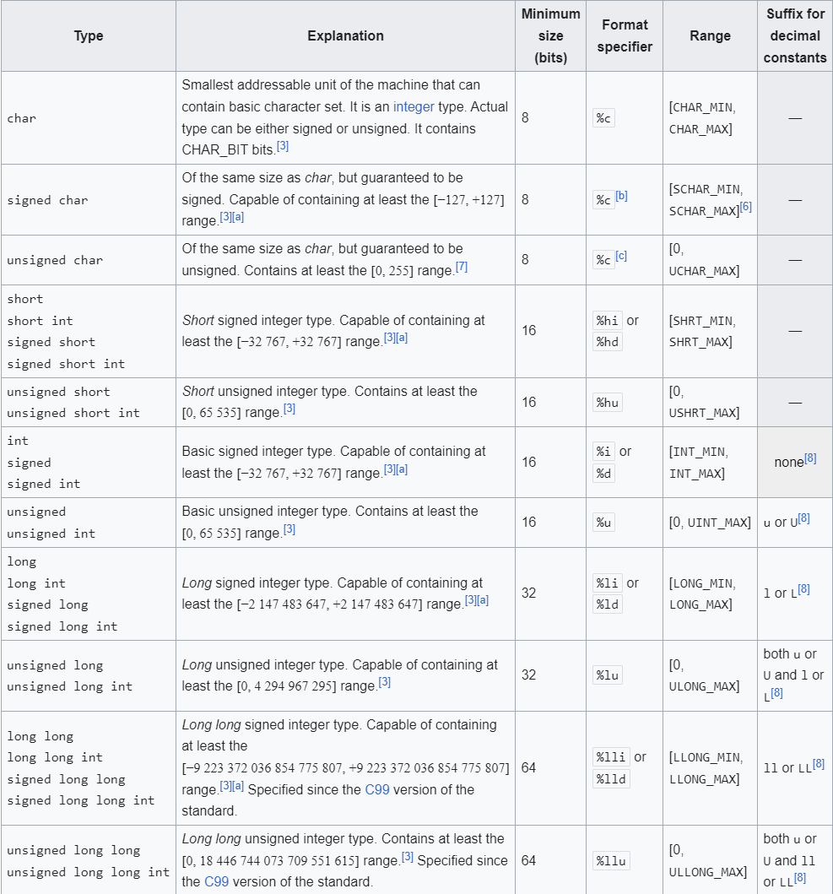
Integer types
Types and type conversion
A lot of different types and signedness
Normally 8-64 bits
No guarantee for size, just a minimum
Signed variables usually stored as two’s complement

Slide 13
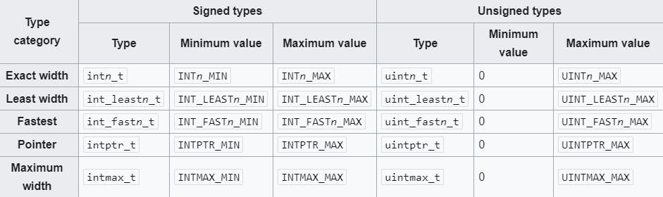
Integer types
Types and type conversion
stdint.h
Implements a clear size of variables

Slide 14
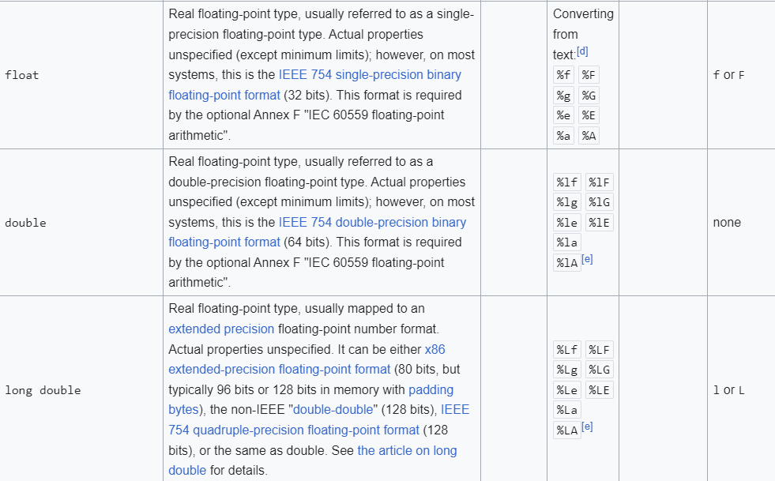
Floating types
Types and type conversion
Different precision, but 32 bits are usually good enough

Slide 15
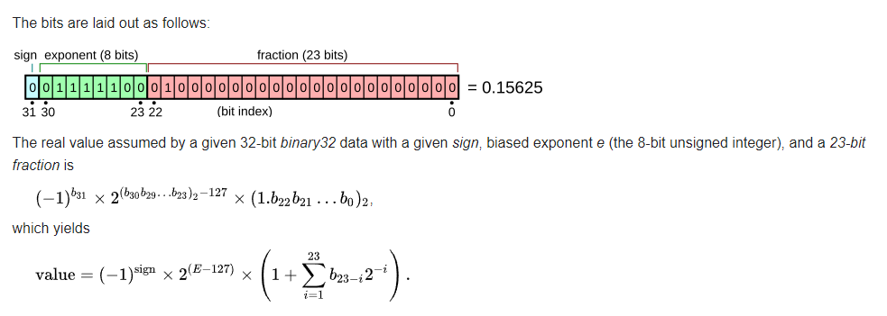
Floating types
Types and type conversion
Detailed knowledge usually not needed, but could in some cases be very useful

Slide 16
Type conversion
Types and type conversion
Switching between types is very common
Can be implicit or explicit, try to always be explicit
Compiler/target can affect result
Mistakes in type conversion a common issue
Static code analysis tools can help with this
Can also be very useful if done correctly

Slide 17
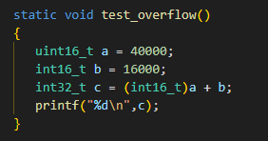
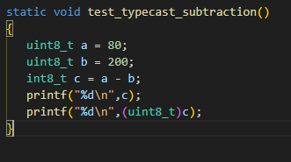
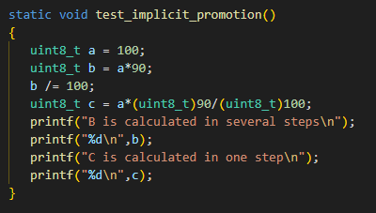
Type conversion
Types and type conversion
Examples

Slide 18
Boolean expressions

Slide 19
Boolean values
Boolean expressions
True booelans doesn’t exist in C
stdbool.h from C99 provides some support
All booleans are ints

Slide 20
Boolean operations
Boolean expressions
AND &&
OR ||
NOT !
Equals ==
Not equal !=
Greater then >
Less then <
Greater or equal >=
Less or equal <=

Slide 21
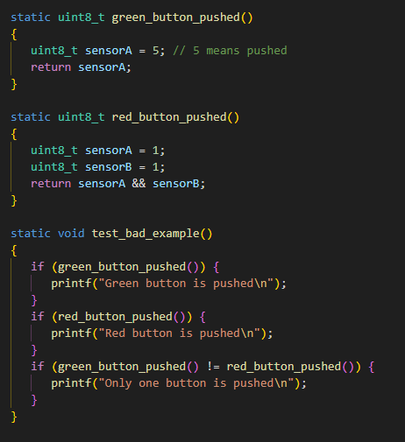
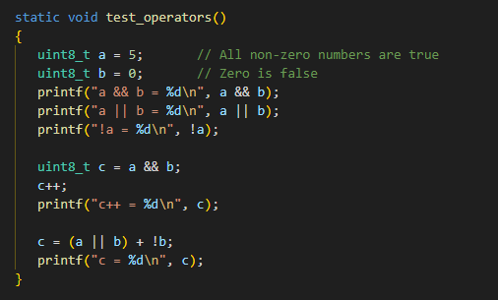
Examples
Boolean expressions

Slide 22
Bit operations

Slide 23
Bit operations
Bit operations
Bitwise AND &
Bitwise inclusive OR |
Bitwise exclusive OR (XOR) ^
Shift left <<
Shift right >>
Bitwise NOT ~

Slide 24
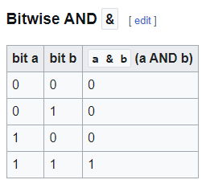
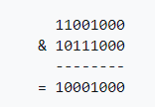
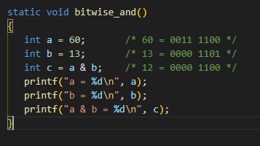
Bitwise AND
Bit operations
Symbol &
Assignment operator &=
Logic equivalent &&
Example

Slide 25
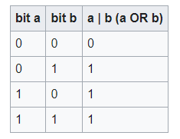
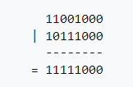
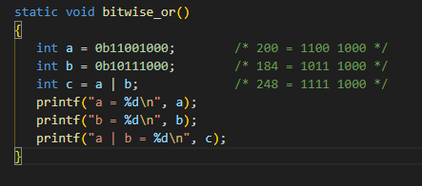
Bitwise inclusive OR
Bit operations
Symbol |
Logic equivalent ||
Assignment operator |=
Example

Slide 26
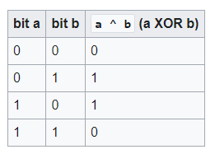
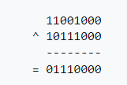
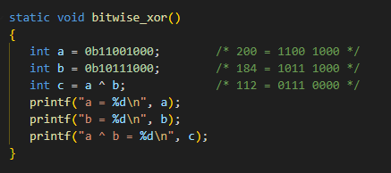
Bitwise exclusive OR
Bit operations
Symbol ^
Logic equivalent =! (but be careful to normalize numbers to logic values first, there are no true Booleans in C)
Assignment operator ^=
Example

Slide 27

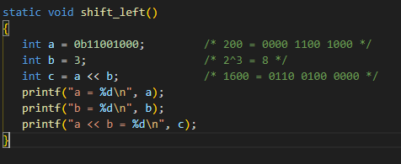
Shift left
Bit operations
Symbol <<
Assignment operator <<=
a << b moves the bits of a, b steps to the left
Essentially multiplies a*2^b
Be careful when shifting signed numbers
Example

Slide 28
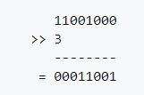
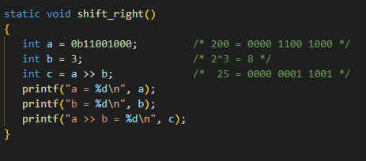
Shift right
Bit operations
Symbol >>
Assignment operator >>=
a >> b moves the bits of a, b steps to the right
Essentially divides a/(2^b)
Be careful when shifting signed numbers
Example

Slide 29

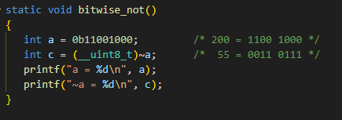
Bitwise NOT
Bit operations
Symbol ~
Logic equivalent !
~a inverts all the bits in a
Example

Slide 30
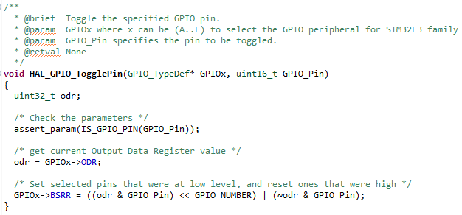
Example
Bit operations
Commonly used when writing to processor registers
Information is commonly stored as bits in larger types and making changes to just one or a few bits can easily be performed with bit operations.

Slide 31
Structs and unions

Slide 32
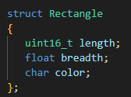
Structs
Struct and unions
Structs are user defined data types
Differ from arrays by being able to contain elements of different types
Can cause alignment issues

Slide 33

Unions
Struct and unions
Unions combine different types in the same memory area
Useful when the same memory area need to be interpreted in multiple ways

Slide 34
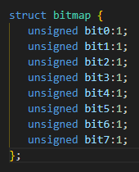
Bitfields
Structs and unions
Type of struct
By specifying size individual bits or bit segments can be accessed
Sometimes the bitmap can feel a bit upside down

Slide 35
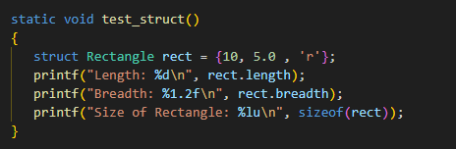
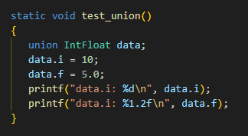
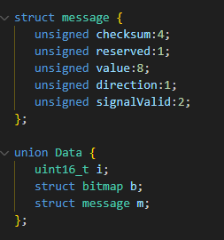
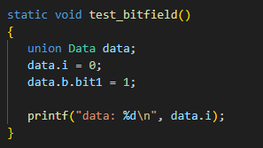
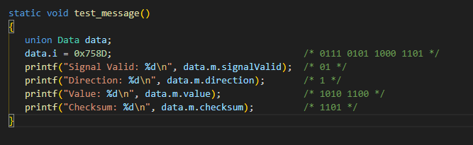
Examples
Structs and unions

Slide 36
Strings

Slide 37
Strings
Strings
There are no strings in C
Stored as char arrays
Requires null termination
Be careful with dynamic memory allocation, try to use static memory

Slide 38
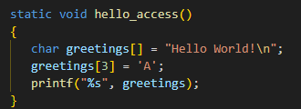
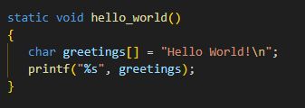
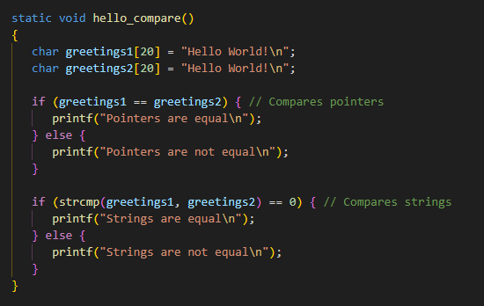
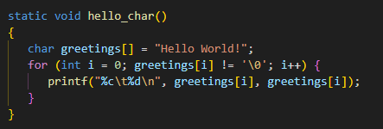
Examples
Strings

Slide 39
Macros and directives

Slide 40
Macros and directives
Macros and directives
Macros are used by the preprocessor of the compiler
Can be used both in code and in logic before compiling code
Preprocessor logic does not allow floating point numbers

Slide 41
Object like macros
Macros and directives
Useful for giving constants pretty names and will only require change in one place
Can be used to enable or disable parts of your code
Can be used to trigger errors at compile time
Used as
#define PI 3.14159

Slide 42

Function like macros
Macros and directives
Macros can define function like behavior
Will be processed before compilation, thus getting an inline behavior, avoiding function jumps
Note the difference between
Good for speed but harder to debug, generally only use for simple functions

Slide 43
Directives
Macros and directives
Directives are different commands sent to the preprocessor to achieve certain behavior
The most common ones include
#include
#define
#undef
#if
#ifdef
#ifndef
#error

Slide 44
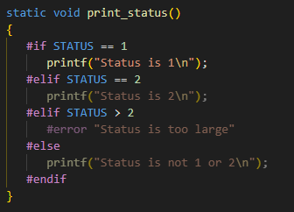
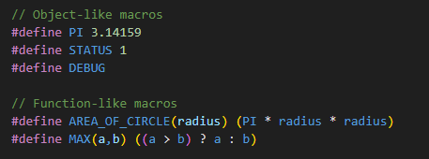
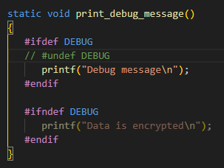
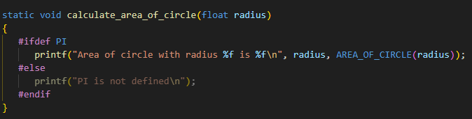
Examples
Macros and directives

Slide 45
Pointers

Slide 46
Overview
Pointers
Pointers are, for most people, the most complex part of C programming
When used correctly they can be very powerful
Adds complexity to the code
Useful for functions which need to return more than one variable
Useful when passing arrays to functions
Can have pointers to pointers
NULL pointers make all kinds of crazy things

Slide 47
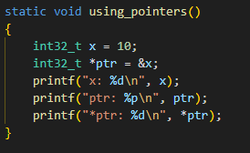
Accessing pointers
Pointers
A pointer is declared by adding a * after the type
Referencing a variables address is done by adding an & before the variable
Derefencing a pointer to access its value is done by adding a * before the pointer

Slide 48
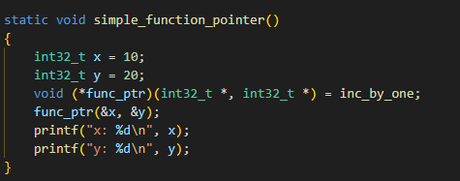
Function pointers
Pointers
A pointer can also point to a function, which then can be called with corresponding arguments
Useful when switching between different interfaces
Makes code structures harder to follow

Slide 49
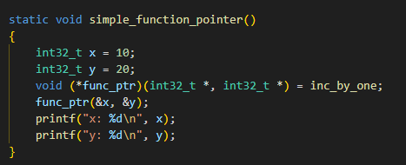
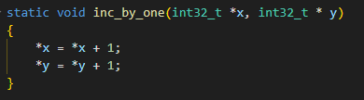
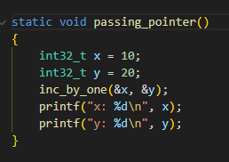
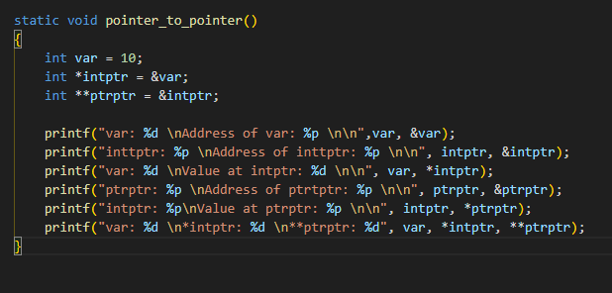
Examples
Pointers

Slide 50
Summarizing example

Slide 51
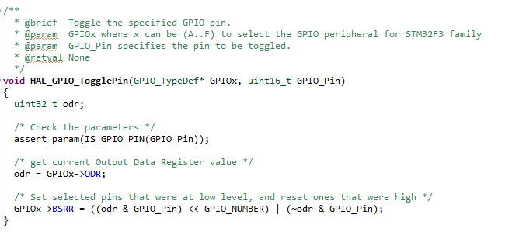
Function pointers
Pointers
Simple function to just toggle a pin
Gets GPIOx as a struct pointer argument
assert_param and IS_GPIO_PIN are nested function-like macros which uses boolean logic
GPIO_NUMBER is an object like macro
Uses a lot of bitwise operators to write to the correct processor registers
Since odr is a uint32_t variable and GPIO_Pin is a uint16_t we get an implicit type conversion

Slide 52
Questions?

